Slide 1



Trac·Hack
Challenge
Team 5- Spark
Junlin Wu, Nan Zhou, Wenhan Sun, Xiaoli Han, Linyi Du

Slide 2

Overview
Goal: Status Prediction
Data Preprocessing
Feature Engineering
Models
Experience

Slide 3
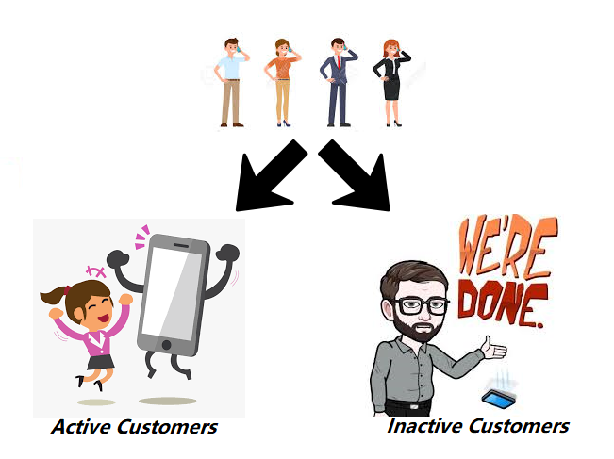
Goal: Status Prediction
Active vs Inactive
Predict customers status between Mar 20 and Apr 2 using customer information in the previous period.

Slide 4
Data Preprocessing
Features with over 70% missing values were deleted.
Eg. customer birth year.
Constant features and those are nearly zero-variance.
Eg. states of customer sources, customer activation channels, etc
Notes:
After doing the above work, we end up with getting features in the next page.
11 features

Slide 5
Feature Engineering - Initial Features
Identity:
Line id
Time related:
first activation date, deactivation date, reactivation date
Consumption history:
Life-time redemptions and revenues
Services:
Support case status, sms, # of voice…
Others:
phone operating system and generation

Slide 6
Feature Engineering - Created Features
We combine features which deliver the same type of information together:
“tenure”: duration between first activation date and 03/19, or the latest deactivation date
“average sms”: (“sms_in” + “sms_out”) / “tenure”
“# of cases” : # of support cases per customer
The information is helpful as it tells us how much customers are addicted to TracFone’s services.
Notes:
After selected the initial features, we then combined features ...

Slide 7
Feature Engineering - Final Features
Numerical features:
# of cases
lifetime redemptions, and revenues
average sms amount, voice duration, and # of voice
Categorical:
operating system
phone generation
Notes:
After doing all the previous work, we now come to our final features, there are 8 features in total.
For numeric ones, we used
For categoricals, we chose
Next, Xiaoli will talk about the model fitting part

Slide 8
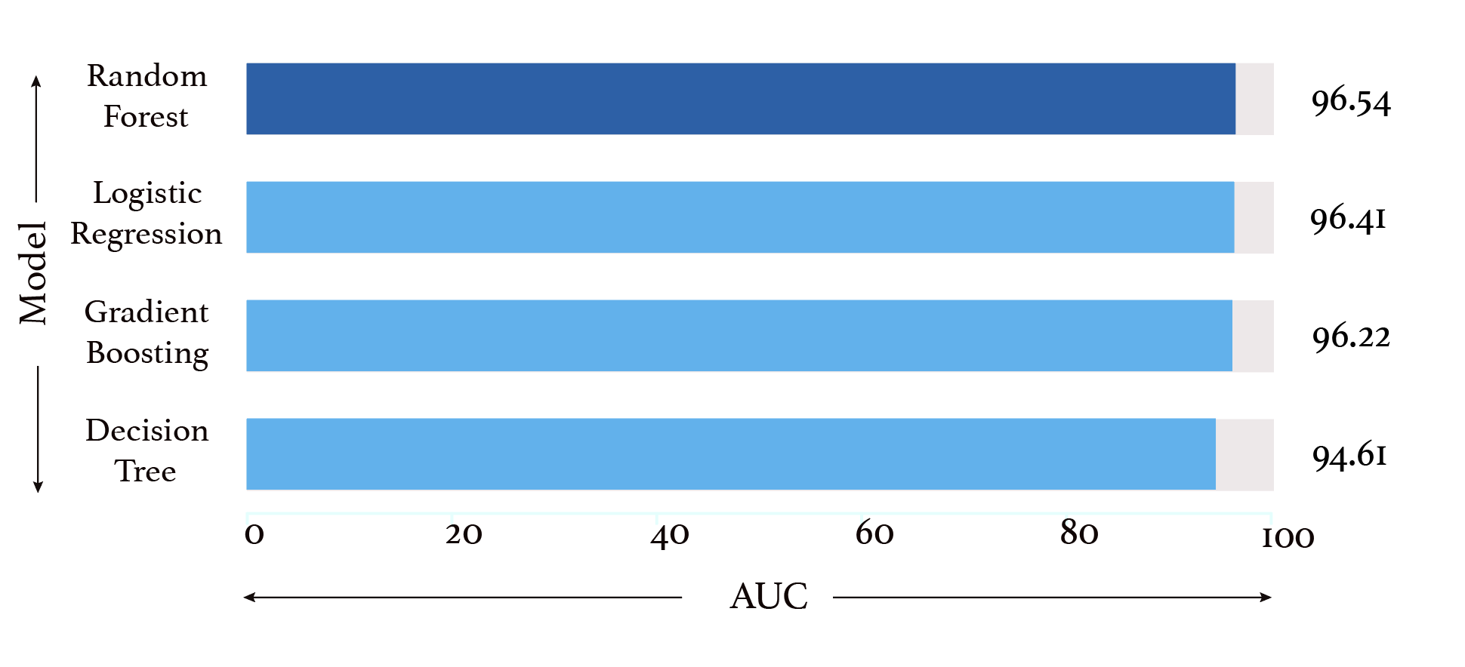
Models

Slide 9
Experience
Teamwork: assign work based on teammates strengths
Workflow: draw a specific outline at the very beginning
Data Exploration: understand the business meanings of each feature
Model Understanding: understand pros & cons of each model as well as the popular uses
Communication: have more effective discussions

Slide 10
Q & A

Slide 11
Thank you!

Slide 12
Appendix A - Initial Features Name
customer_info | deactivations | network-usage-domestic
line_id, first_activation_date, lifetime_redemptions, lifetime_revenues | deactivation_date | sms_in,sms_out, voice_duration_in, voice_duration_out, voice_num_total
phone-info | reactivations | support-history
operating_system, phone_gen | reactivation_date | case_status

Slide 13
Appendix B - Impute Missing Values
For numeric features, there are two kinds of possible missing values. One is that it is indeed never happened, like the number of support cases, we imputed zero to it. For the others, by reviewing at the data distribution and assign median to them.
For categorical features “operating system” and “phone gen”, we assign “unknown” to the missing values since the information is missing and the values may vary very randomly.

Slide 14
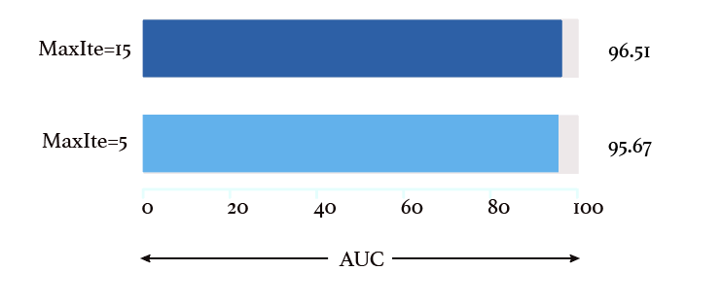
Appendix C - Gradient Boosting Hyperparameter:
Max Iteration
Here, we take Gradient Boosting Model as an example to show how we tune parameters.
After testing 5 and 15 on the hyperparameter of Max Iteration, we found that MaxIte =15 has a better performance.
Notes:
In the following two slides, we will show how we tune hyperparameters.

Slide 15
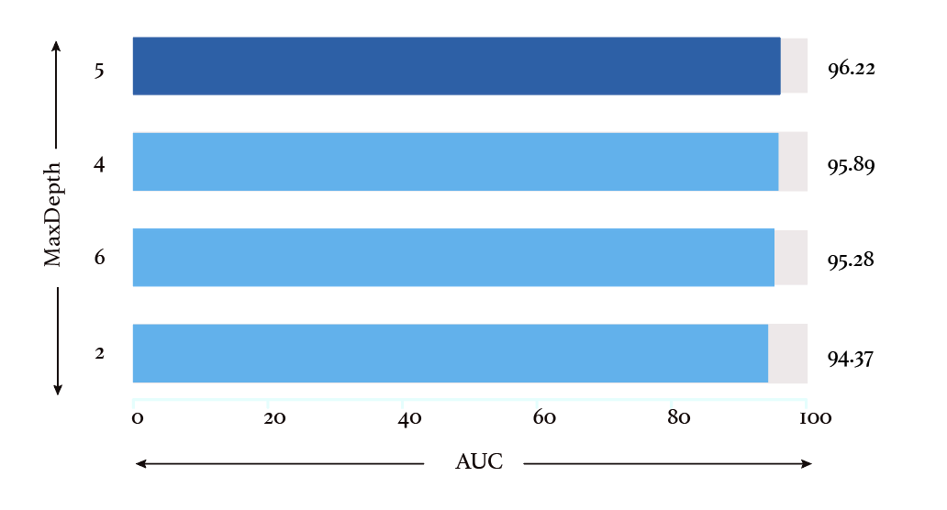
Appendix D - Gradient Boosting Hyperparameter:
Max Depth
After testing several hyperparameters of Max Depth, we found that MaxIte =5 has the best performance.

